Slide 1

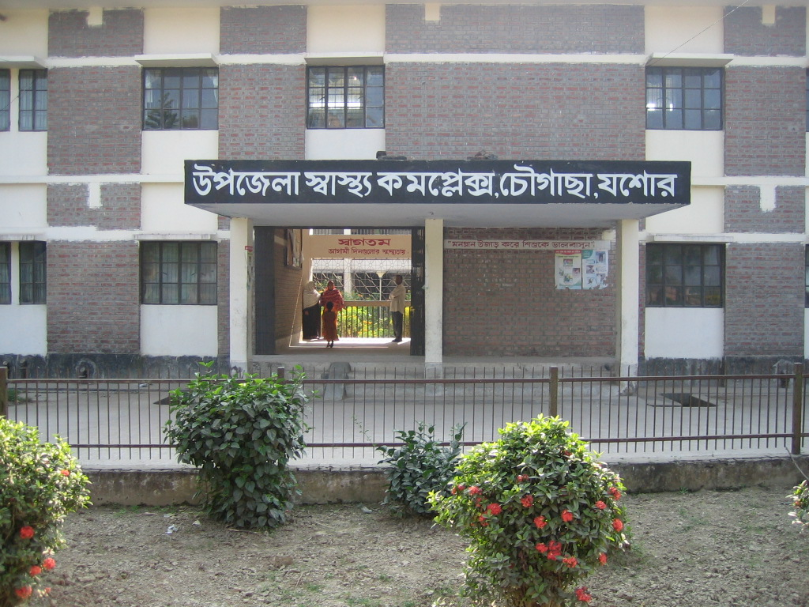
UPAZILA HEALTH COMPLEX
Chowgacha, Jessore.
Dr. Emdadul Haque
Jn. Consultant (Obst & Gynae)

Slide 2
A Sub-district level Women-Friendly Hospital with a Vision …
Motivation of doctors
Maximum utilization of Govt.
resources with
honesty and sincerity
Integrated approach of
Administration, Community
Leaders & Health
Management
Providing Effective and
prompt services
through improved
management system

Slide 3
Health Profile of Chowgacha Upazila- 2010
Total population : 245730
Total Fertile Couples : 52268
Total Pregnant : 5208
Total Delivery : 4427
Total Live birth : 4312
Total death : 932
Total Maternal death : 02
Health Man power
a. Doctor : 19 ( 11 + 8)
b. Nurse : 14+4
c. HA : 25
d. SBA : 13( 3HA+10 FWA )
e. Volunteer, Security guard & cleaner: 36
9. Health Institutions
a. Health Complex : 01
b. H & FWC : 11 (RD- 4 + FWC– 7 )
c. Community clinic : 23
d. Non- Govt. Clinic : 03

Slide 4
10. Mother Taken-ANC : 143% ( 1st Visit)
11. Hospital Delivery Rate : 84.8% (3755)
12. Total C. Section rate : 21.7% (962)
13. No. of Hospital bed : 50
14. Bed Occupancy Rate : 200%
15. Maternal Mortality Ratio : 42 / 100000 live Birth
16. Neonatal Mortality Rate : 16.7 / 1000 live birth
17. Infant Mortality Rate : 20.6 /1000 live birth
18. Under-5 Mortality Rate : 22.7 /1000 live birth

Slide 5
Background History of MCH services of Chowgacha Health Complex, Jessore
To reduce Maternal and Child Mortality and Mobility and to ensure
the quality services to the mother and child, UHFPO opened 4
special activities headed by medical officers in Feb. 1996. And
from January 1997 to 2000 JICA helped us by Frontline MCH
Program to implement the program by giving technical and
logistic supports.
<4 Special activities>
ANC-Corner – leaded by female Medical Officer for pregnant mother for effective ANC services who receive TT immunization in the Health Complex
Basic EOC service by a Gyne & Obs. trained MO
Under 5 corner for under 5 children for their nutritional assessment and treatment by RMO.
Monthly birth and death record by specially developed format by health assistant throughout the Upazilla to asses the progress of maternal and child health status by health indicators supervised by UH&FPO

Slide 6
Contd.
From Dec. 1999 Reproductive Health Department of DGHS and UNICEF gave logistic supports and human resources development (like medical officer trained in anesthesia).
Form November 2000 started Comprehensive EOC program
In 2004, 2005, 2006, 2007 , 2008 & 2009 the UHC was awarded by the Bangladesh Government and UNICEF for best performance on EOC Service.
From August 2006 Safe Blood Transfusion unit established with the aid of UNICEF.
From April 2007 Demand Side Financing (DSF) program started.
Women friendly Hospital declared in 2008.
Hospital is declared as model health complex on 20 June 2008 and upgraded to 50 bedded hospital by Secretary of Ministry of Health & family welfare.
Chowgacha health complex Model is replicable through out the country. Declared by Dr. Margaret Chan, D.G. WHO on 8th March 2010.

Slide 7
Upazila Health Complex
CHOWGACHA , JESSORE.
Emergency & Out door Service 2005 to 2010
Sl No | Year | Emergency Patients | Out door Service
01 | 2005 | 4308 | 80591
02 | 2006 | 4091 | 84301
03 | 2007 | 4287 | 105963
04 | 2008 | 4275 | 120117
05 | 2009 | 5144 | 126369
06 | 2010 | 7071 | 95958

Slide 8
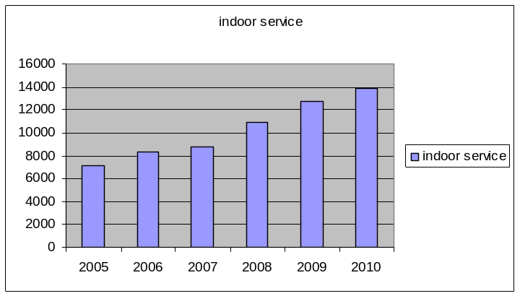
Upazila Health Complex
CHOWGACHA , JESSORE.
Indoor Service 2005 to 2010
Sl No | Year | indoor Service | No of Bed | Bed occupancy rate
01 | 2005 | 7126 | 31 | 158.0%
02 | 2006 | 8355 | 31 | 182.0%
03 | 2007 | 8743 | 31 | 201.0%
04 | 2008 | 10944 | 50 | 199.0%
05 | 2009 | 12717 | 50 | 185.0%
06 | 2010 | 13887 | 50 | 199.7%

Slide 9
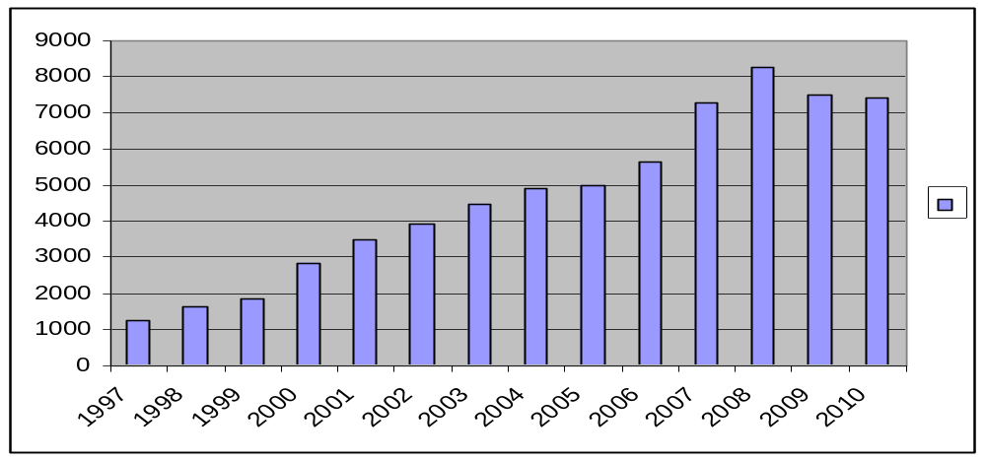
Upazila Health Complex
CHOWGACHA , JESSORE.
EOC Activities : 1997- 2010 (ANC First Visit)
8263
7292
7499
7427
5644
4898
4993
4484
3932
3509
2861
1631
1851
1228

Slide 10
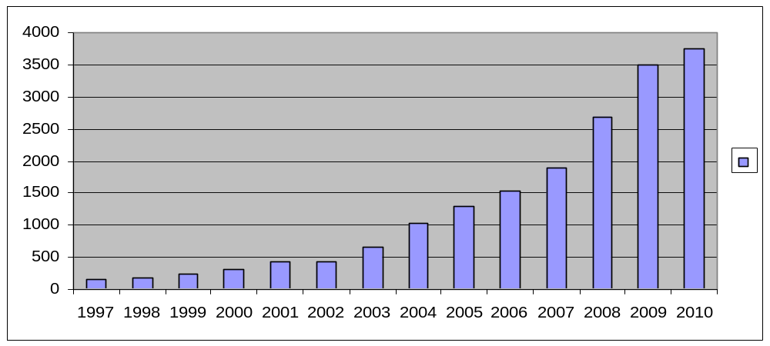
Upazila Health Complex
CHOWGACHA , JESSORE.
EOC Activities : 1997- 2010 (Hospital Delivery )
3755
3489
2682
1899
1518
1293
1030
661
312
421
422
151
182
228

Slide 11
Upazila Health Complex
CHOWGACHA , JESSORE.
Comparative Data of Delivery of best performing EOC center of Khulna Division in 2009
SL No | Name of institute | NVD | Vacuum Del. | V. Breech | C. Section | Total
01. | Chowgacha UHC | 2552 | 58 | 37 | 842 | 3489
02. | Ad-din Hospital Jessore. | 1113 | 0 | 0 | 1645 | 2758
03. | KMCH Khulna | 1387 | 56 | 5 | 928 | 2376
04. | 250 bed Hospital, Khustia | 1435 | 0 | 26 | 881 | 2342
05. | 250 bed Hospital, Jessore | 871 | 0 | 0 | 1278 | 2149
06. | Fatima Hospital Jessore. | 586 | 0 | 7 | 1096 | 1689

Slide 12
7th Five Year Plan.(2018-2022)
Sl No | Indicator | Target 2022. | Achievement in 2019 | Target in 8 th 5yr.plan | SDG
1 | MMR/100000LB | 105 | 165 | 100 | 70
2 | NMR/1000LB | 18 | 15 | 14 | 12
3 a b | IMR/1000LB Under 5MR/1000LB | 20 37 | 21 28 | 18 27 | - 25
4 | Deivery by trained person(%) | 65% | 59%
5 | Instituional delivery rate
6 | ANC 4th Visit rate | 50% | - | -
 | Malnutrtion rate(<5yr) | 20% | 32.6% | 20%
8 | Stanting rate (<5yr) | 25% | 28% | 25%
9 | Immunization coerage rate | 95% | 86% | 98%
10 | T.B Case detection | 75%

Slide 13
7th Five Year Plan:2018-2022
Sl No | Indicator | Target 2022 | Achieve in 2019 | Target in 8 th 5yr plan by 2025 | SDG
11 | CPR | 75%
12 | TFR | 2.0 | 2.04 | 2.0
13 | Adolescence fertility rate 15-19yr./1000 fertile cuple. | 25 |  |  | 17
14 | Exclusive B.Feeding rate
15 | Death due to NCD/1000 pop(30-69 yr)( % of total death)
a. | Heart disease |  | 15.16%
b. | Stroke |  | 18.74%
c. d. | Cancer Diabetes |  | 10.68% 04.05%
e. | Chr. Resp. Disease |  | 06.38%
f. | RTA(%of total death) |  | 03.50%

Slide 14
Status in HSS score of the UHCs of Tangail district. from Jan to June2022 .
SL No | Name of institute | Jan | Feb | March | April | May | June
01. | ModhupurUHC | 73 | 20 | 16 | 7 | 32 | 34
02. | Ghatail UHC | 110 | 115 | 262 | 160 | 223 | 144
03. | Kalihati UHC | 26 | 41 | 38 | 39 | 69 | 69
04. | Sakhipur UHC | 77 | 254 | 91 | 123 | 136 | 143
05. | Nagorpur UHC | 168 | 212 | 254 | 171 | 204 | 169
06. | .Dhanbari UHC | 247 | 155 | 194 | 129 | 187 | 108
07 | Mirzapur UHC | 146 | 167 | 160 | 130 | 78 | 150
08 | Delduar UHC | 180 | 195 | 232 | 278 | 298 | 287
09 | Basail UHC | 99 | 137 | 141 | 173 | 125 | 289
10 | Gopal pur UHC | 138 | 127 | 138 | 140 | 192 | 82
11 | Bhuapur UHC | 176 | 227 | 247 | 162 | 127 | 102

Slide 15
Improved display system in a UHC
Proposed area
1.UH&FPO room.
2.Emergency Deptt.
3.ANC Crner.
4.NCD corner.
5.IMCI corner.
6.Breast feeding corner.
7.Pathology deptt.
8.Birth & death recording system
9.VIA Corner.
10.Heanth education Corner.
11.Display of doctors informations.
12. Hospital & Field activites display.

Slide 16
Factors Responsible for Reduction of Maternal and Infant Mortality Rate in Chowgacha
Special Activities initiated by Medical Officers in February 1996:
Setting up ANC Corner – Headed by female Medical Officer for pregnant mother for effective ANC services who receive TT immunization in the Health Complex;
Initiation of Basic EOC Service by a Gyne & Obs. trained Medical officer;
Establishment of Under 5 Corner for under 5 children for their nutritional assessment and treatment by Resident Medical Officer;
Record Keeping of Monthly Birth and Death by specially developed format by health assistant throughout the Upazilla supervised by UH&FPO;
Wide and Continuing Dissemination of Health Promotion ad Education Messages among women coming for antenatal care, pregnant women and general patients and their attendants at all corners;
One Package Service Corner from where we provide ANC registrations, EPI fixed centre, ORT service, audio-visual health educations and health nutritional education;

Slide 17
Factors Responsible for Reduction of Maternal and Infant Mortality Rate in Chowgacha- Contd.
Maintaining all criteria for woman friendly hospital like separate female pts. registration, separate ANC service by female doctor;
Rest Room for Pregnant Women where health education is given daily by nursing supervisor & audiovisual system;
Operating Blood Bank System by registered about 600 donors addresses within 1 km. radius of the hospital; Community supports like ANC card, blood grouping reagents, etc.;
Mobile phone in emergency, indoor, EOC to provide telephonic health service facility and emergency ambulance service;
Well equipped Emergency Department supported with spot light, sterilizer, emergency drugs and Oxygen & others;

Slide 18
Upazila Health Complex
CHOWGACHA , JESSORE.
Community Support
Protocol board donated b y Deputy Commissioner Jessore.
Blood Group reagents and blood bags donated by Chairman Chowgacha up at first in
1996 & recently blood bags donated by 11 UP chairman .
ANC& growth monitoring card donated by Ad-Din hospital , JICA , Upazilla Parishad and
ACI Pharmaceutical.
One IPS & 2 cleaners donated by Chairman Municipalities.
Salary of Aya, ward boy, Cleaners Security guard and other supporting stuffs (36 in no.)
are donated by the community.
Mobile phone, Dustbin and salary of 7 manpower donated by Mr. Hasnuzzaman Rahin,
Industrialist and recently he give the support of about one lack TK. for making a reception centre, tiles around the pillars of outdoor and beautification of road.
Drugs for Arsenicosis donated by Upazila Parishad.
Salary of 01 cleaner donated by Mr. Abdur Kader pintu, Industrialist.
Supply of Matir Bank by Some NGOs.
1st Annual Report 1997 printed and all time Computer’s support by Grameen Unnayan
Sangstha ( GUS) NGO, Chowgacha.
2 Tyars of Ambulance donated by 11 UP chairman.
Blood donated by about 732 enlisted blood donors in emergency need (Transfusion of 165
bag F/blood are given in 2009)
Fuel of Generator donated by Upazilla Parishad and UNICEF through WF.
Various types of donations by the doctor's of the hospital.
Out door and indoor tickets donated by Pharmaceuticals.

Slide 19
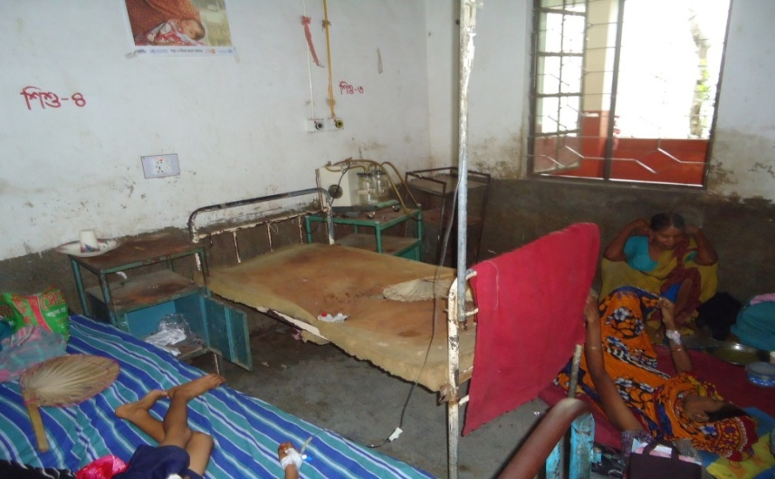

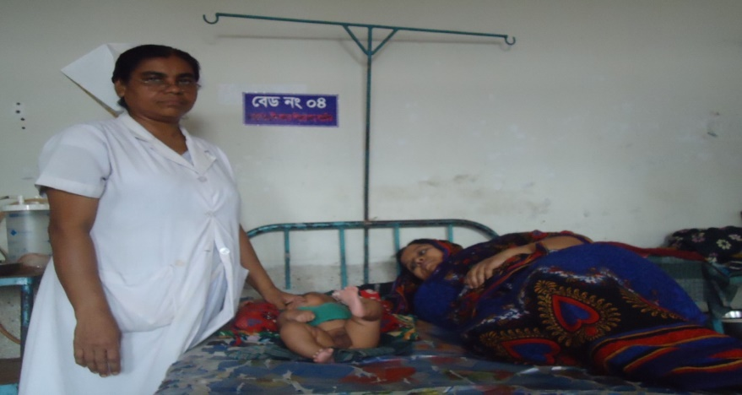

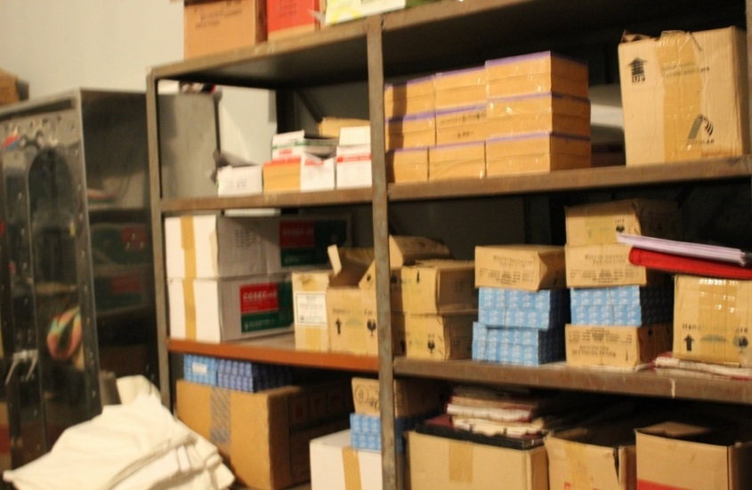
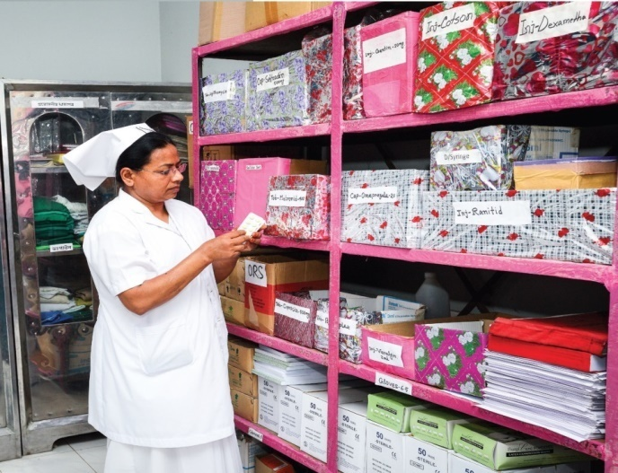
Changes in Pediatric Ward and EOC Ward
Before
After

Slide 20
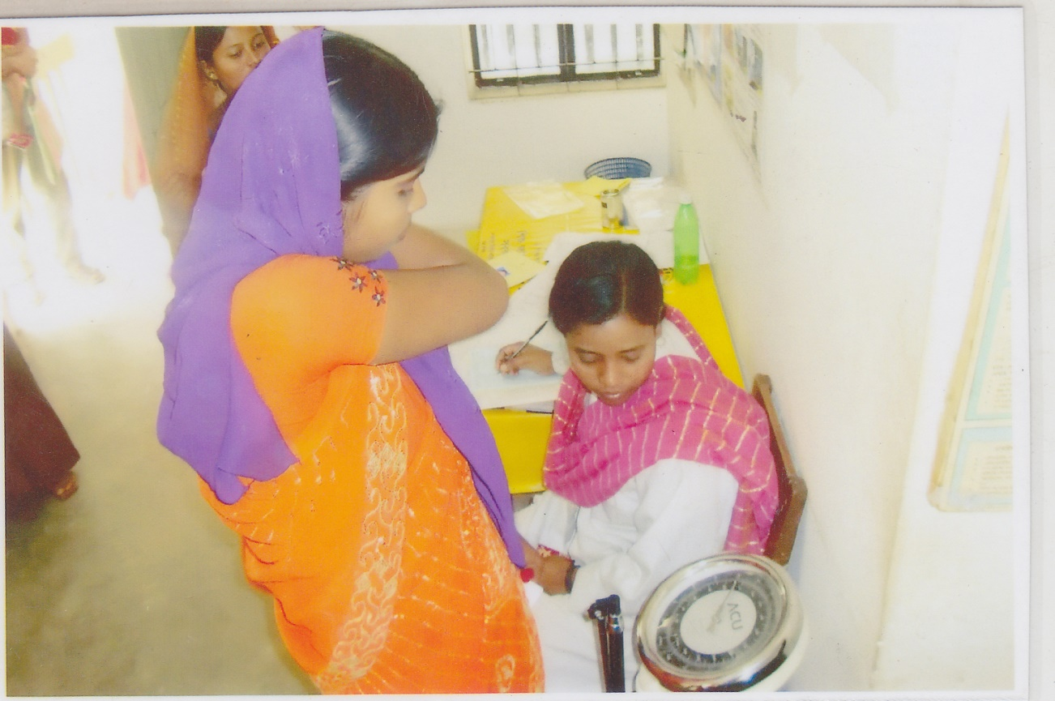
Registration & weight recoding by volunteers

Slide 21
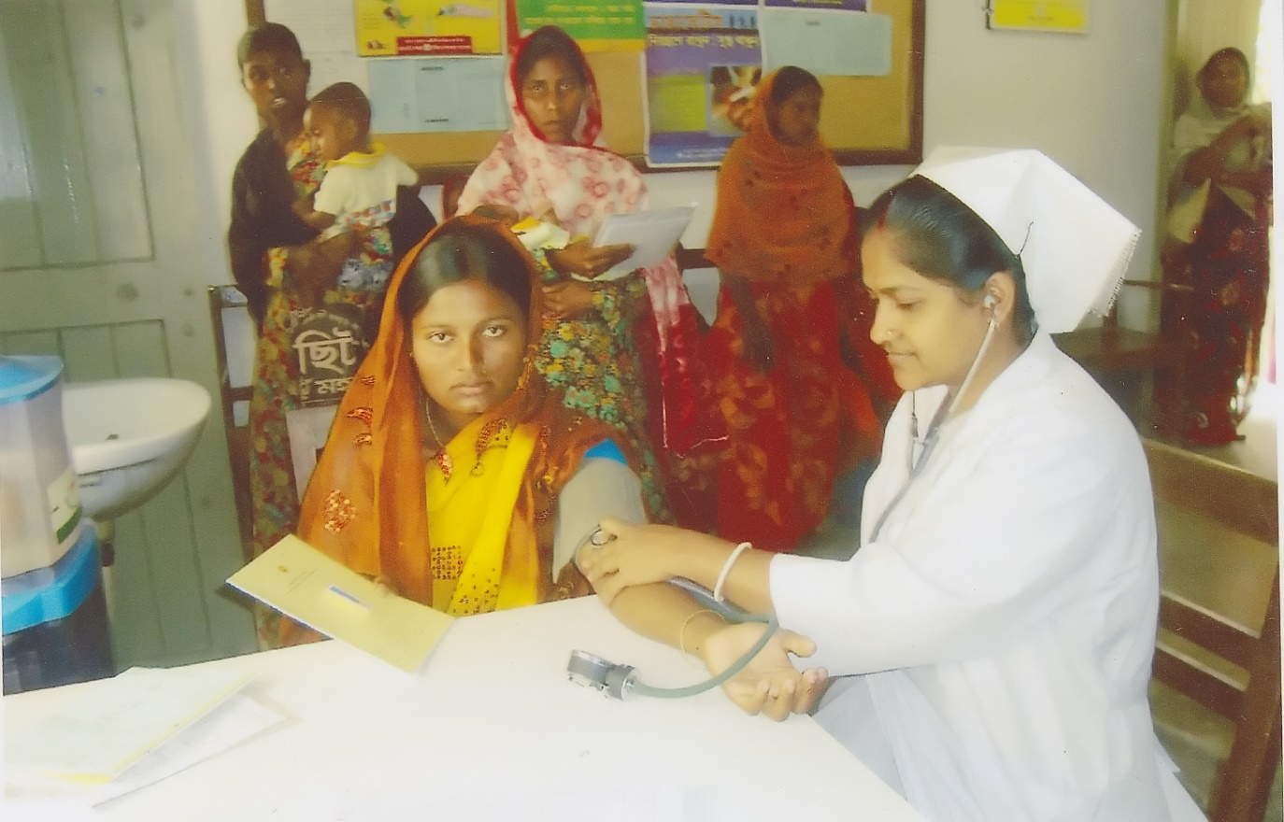
Blood presser is recorded by S.S.N

Slide 22
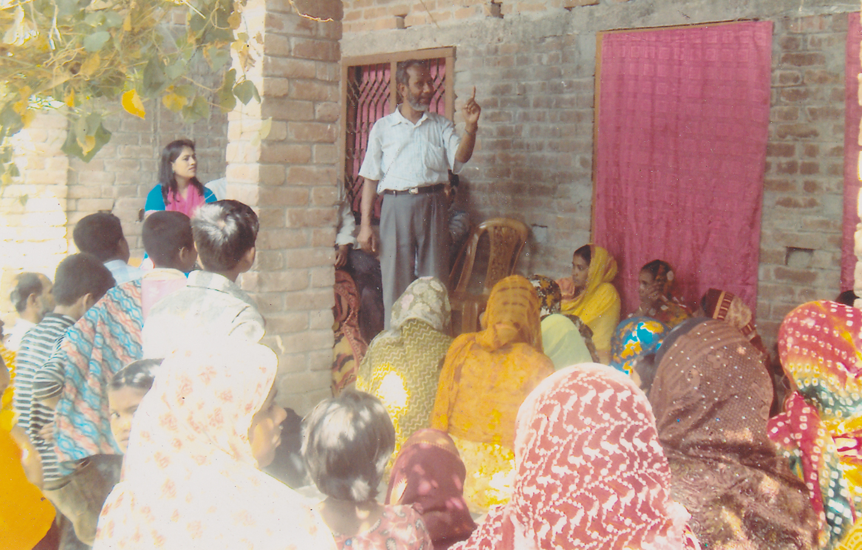
Health Education in Uthan Boithok in a rural village.

Slide 23
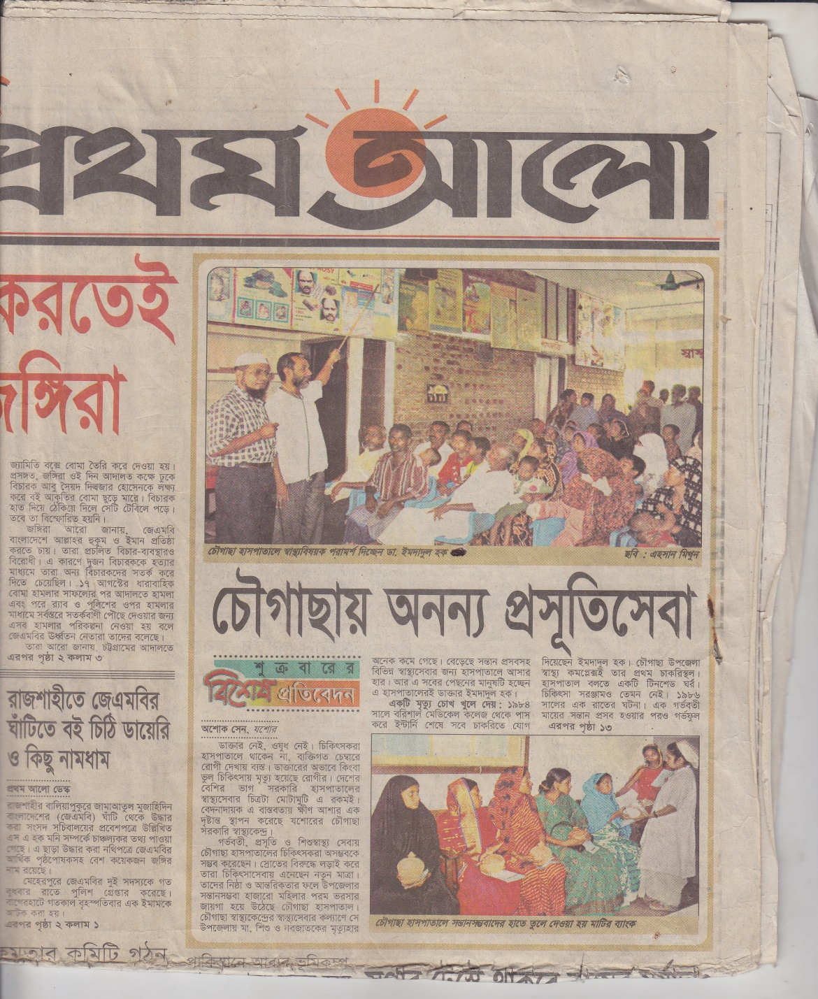
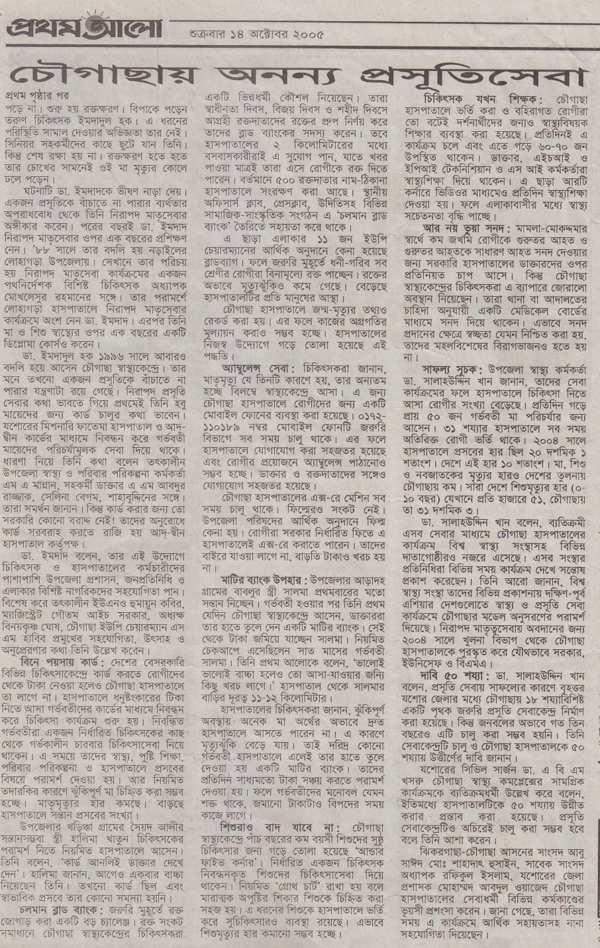

Slide 24
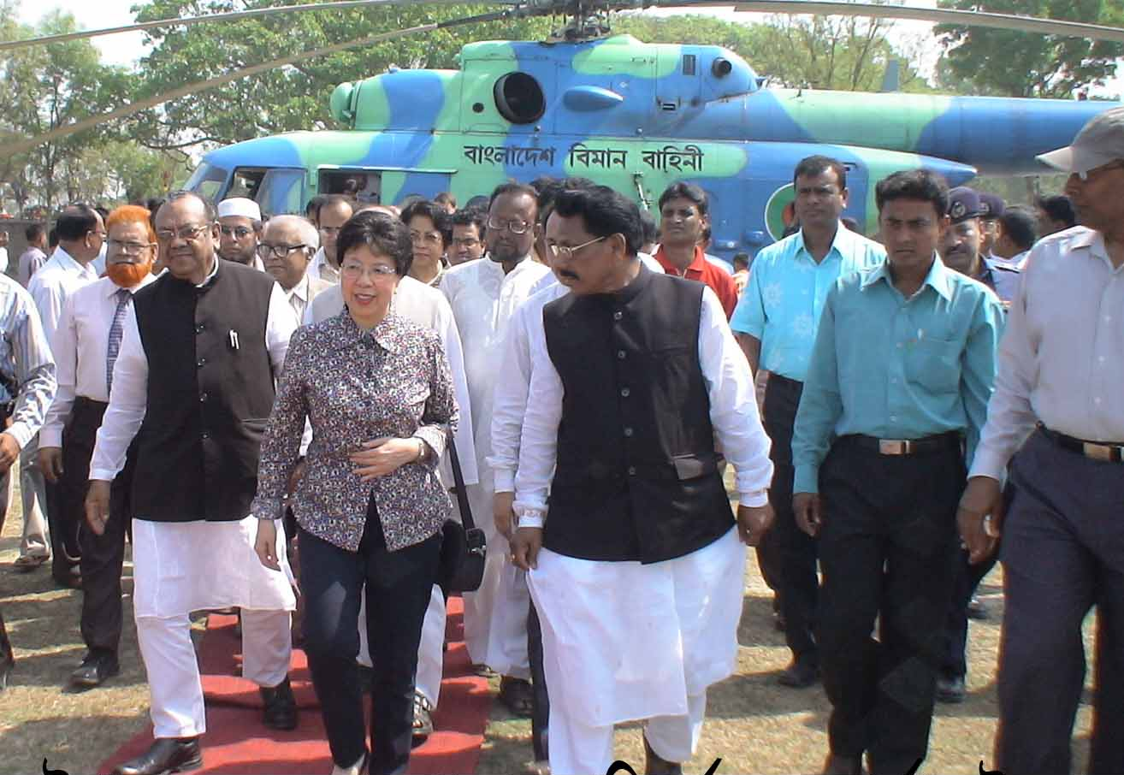
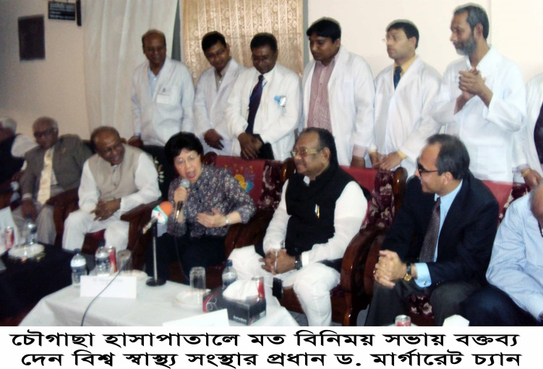
Òevsjv‡`‡ki Rb¨ ewnt we‡k¦i
†Kvb g‡W‡ji cÖ‡qvRb †bB|
†PŠMvQv g‡WjB h‡_ó ,
†PŠMvQv ¯^v¯’¨ †mevq `w¶Y
c~e© Gwkqv‡Z GKwU `„óvšÍ ¯’vcb K‡i‡Q|Ó
†PŠMvQv g‡Wj nvmcvZvj cwi`k©bKv‡j
W. gvM©v‡iU P¨vb (gnvcwiPvjK, wek¦ ¯^v¯’¨ ms¯’v)

Slide 25

Thank you

Slide 26
Upazila Health Complex
CHOWGACHA , JESSORE.
7th Five year plan:2018-2022.
Sl No | Indicator | Target 2022 | Achieve in 2019 | Target in 8 th 5yr plan by 2025 | SDG
15 | Death due to NCD/1000 pop(30-69 yr)( % of total death)
a. | Heart disease |  | 15.16%
b. | Stroke |  | 18.74%
c. | Diabetes |  | 04.05%
d | Chr. Resp. Disease |  | 06.38%
e. | RTA(%of total death) |  | 03.50%

Slide 27
Upazila Health Complex
CHOWGACHA , JESSORE.
7th Five year plan:2018-2022.
Sl No | Indicator |  |  | 2020(Status)
f | Cancer |  |  | 10.68%(60,817)
 | Esophageal Cancer |  |  | 2.73% (19,525)
 | Oral Cancer |  |  | 2.17% (15,511)
 | Lungs Cancer |  |  | 1.70% (12,174)
 | Breast Cancer |  |  | 0.951% (6,808)
 | Stomach Cancer |  |  | 0.95% (6,799)
 | Cervical Cancer |  |  | 0.72% (5,132)
 | Colorectal Cancer |  |  | 0.63% (4,534)
 | Lymphoma |  |  | 0.37% (2,667)
 | Leucoma Pancreas cancer |  |  | 0.26% (1,895) 0.20% (1,414)

Slide 28
7th Five Year Plan, Health, Nutrition and Population Target
_{SL No.} | _{Indicator (effect/ results)} | _{Start Year Info (Start Year)} | The target of 7th Five-Year Plan is only by 2022 | _{SDG by 2030}
1 | life expectancy at birth (in year) | 70.4 (SVRS 2013) | 72
2 | Under five mortality rate (per 1000 live birth) | 46 (BDHS 2014) | 37 | 25
3 | Infant (0-1 yr) mortality rate (per 1000 live births) | 38 (BDHS 2014) | 20
4 | Maternal mortality ratio (per 100000 live birth) | 170 (MMEIG 2013) | 105 | 70
5 | The ratio of underweight children under 5 years (%) | 32.6 (BDHS 2014) | 20
6 | Ratio of stunting in under 5 years children (%) | 36.1 (BDHS 2014) | 25
7 | Total fertility rate (children per head of every woman of reproductive age) | 2.3 (BDHS 2014) | 2.0

Slide 29
8 | Contraceptive prevalence rate (%) | 62.4 (BDHS 2014) | 75
9 | Immunization coverage among Children under the age of one year | 78 | 95
10 | Ratio of childbirth (%) delivery by trained person | 42.1 (BDHS 2014) | 65
11 | Rate of institutional delivery according to wealth status (ratio of highest and lowest fifth) | 15:69.5 (BDHS 2014) | 1:3.5
12 | Tuberculosis identification rate (%) | 53 (GTR 2014) | 75
13 | Neonatal mortality rate per 1000 live birth | 25 (2014) | 18 | 12
14 | The wasting rate of children aged under five years | 14 | 12
15 | Ante-natal Health Care (ANC) 4th visit | 31.2 | 50

Slide 30
_{SL No.} | _{Indicator (effect/ results)} | _{Start Year Info (Start Year)} | The target of 7th Five-Year Plan is only by 2022 | _{SDG by 2030}
16 | Exclusive Breastfeeding infant under 6 months | 55.3 (2014)
17 | Adolescent fertility rate (15-19) per 1000 married couple | 31 | 25 | 17
18 | Deaths due to NCD per ten thousand population (30 - 69 years) |  |  | 18
18. a | Heart disease |  |  | 18. a
18 b | Cancer |  |  | 18 b
18 c | Diabetes |  |  | 18 c
18 d | Chronic respiratory illness |  |  | 18 d

Slide 31
8th Five Year Plan, Health, Nutrition and Population Target
_{SL No.} | _{Indicator (effect/ results)} | Start Year Info (Start Year2019) | The target of 8th Five-Year Plan is only by 2025 | _{SDG by 2030}
1 | life expectancy at birth (in year) | 72.6 (SVRS 2019) | 74
2 | Under five mortality rate (per 1000 live birth) | 28(SVRS-2019) | 27 | 25
3 | Infant (0-1,year) mortality rate (per 1000 live births) | 21(SVRS 2019) | 18
4 | Maternal mortality ratio (per 100000 live birth) | 165 (SVRS-2019) | 100 | 70
5 | The ratio of underweight children under 5 years (%) | 32.6 (BDHS 2014) | 20
6 | Ratio of stunting in under 5 years children (%) | 28%(MICS- 2019) | 25
7 | Total fertility rate (children per head of every woman of reproductive age) | 2.04(SVRS- 2019) | 2.0

Slide 32
8 | Contraceptive prevalence rate (%) | 63.4 (SVRS -2019) | 75
9 | Immunization coverage among Children under the age of one year(%) | 86 (%) | 98(%)
10 | Ratio of childbirth (%) delivery by trained person | 59 (MICS- 2019) | 72
11 | Rate of institutional delivery according to wealth status (ratio of highest and lowest fifth) | 1:3 (BDHS 2019) | 1:1.5
12 | Tuberculosis incidance rate /1,00,000 pop. | 221(GTR-2019) | 112
13 | Neonatal mortality rate per 1000 live birth | 15 (SVRS-2019) | 14 | 12
14 | Mortality rate by NCD(Cardiovascular, Cancer Diabetis, Chorinicrespiratory illness) (%) | 21.6(WHO-2019) | 16.8
15 | Ante-natal Health Care (ANC) 4th visit

Slide 33
_{SL No.} | _{Indicator (effect/ results)} | _{Start Year Info (Start Year)} | The target of 7th Five-Year Plan is only by 2025 | _{SDG by 2030}
19 | Mortality in road traffic accidents (per 100,000 population)
19a. | Male
19 b. | Women
20. | Smoker's rate (every 100,000 population) in 15+ years

